Slide 1
The Parish of ash
Neighbourhood Development Plan (NDP) Data

Slide 2
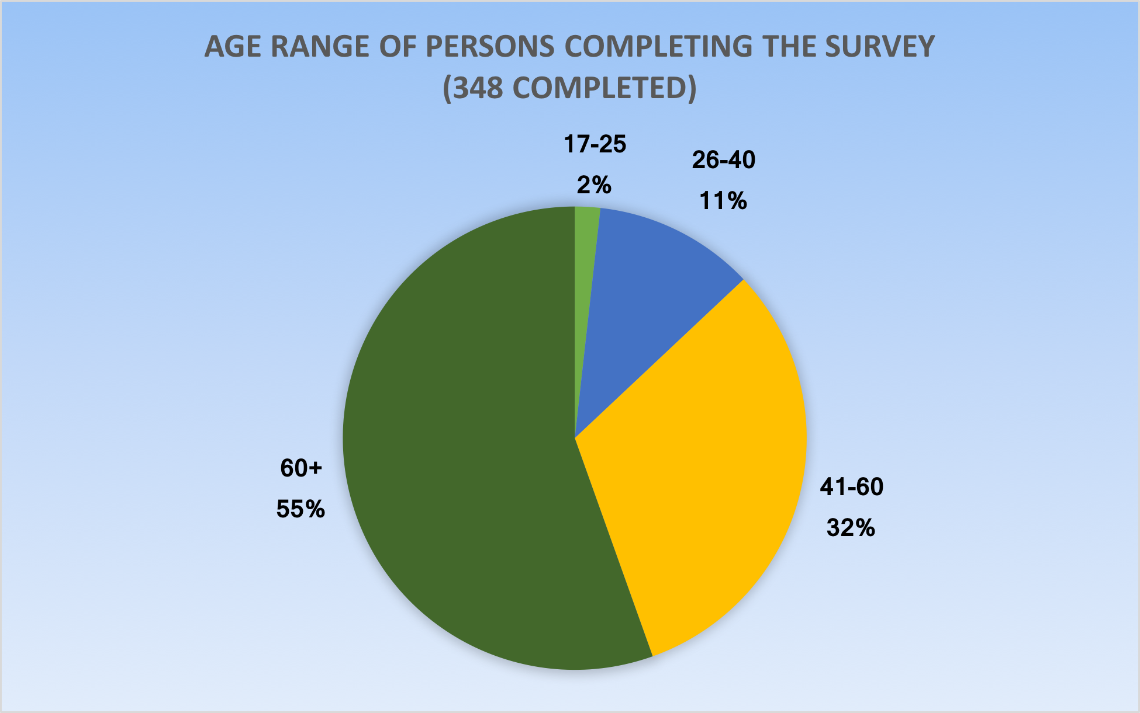
Age Range of Persons Completing The NDP Survey

Slide 3
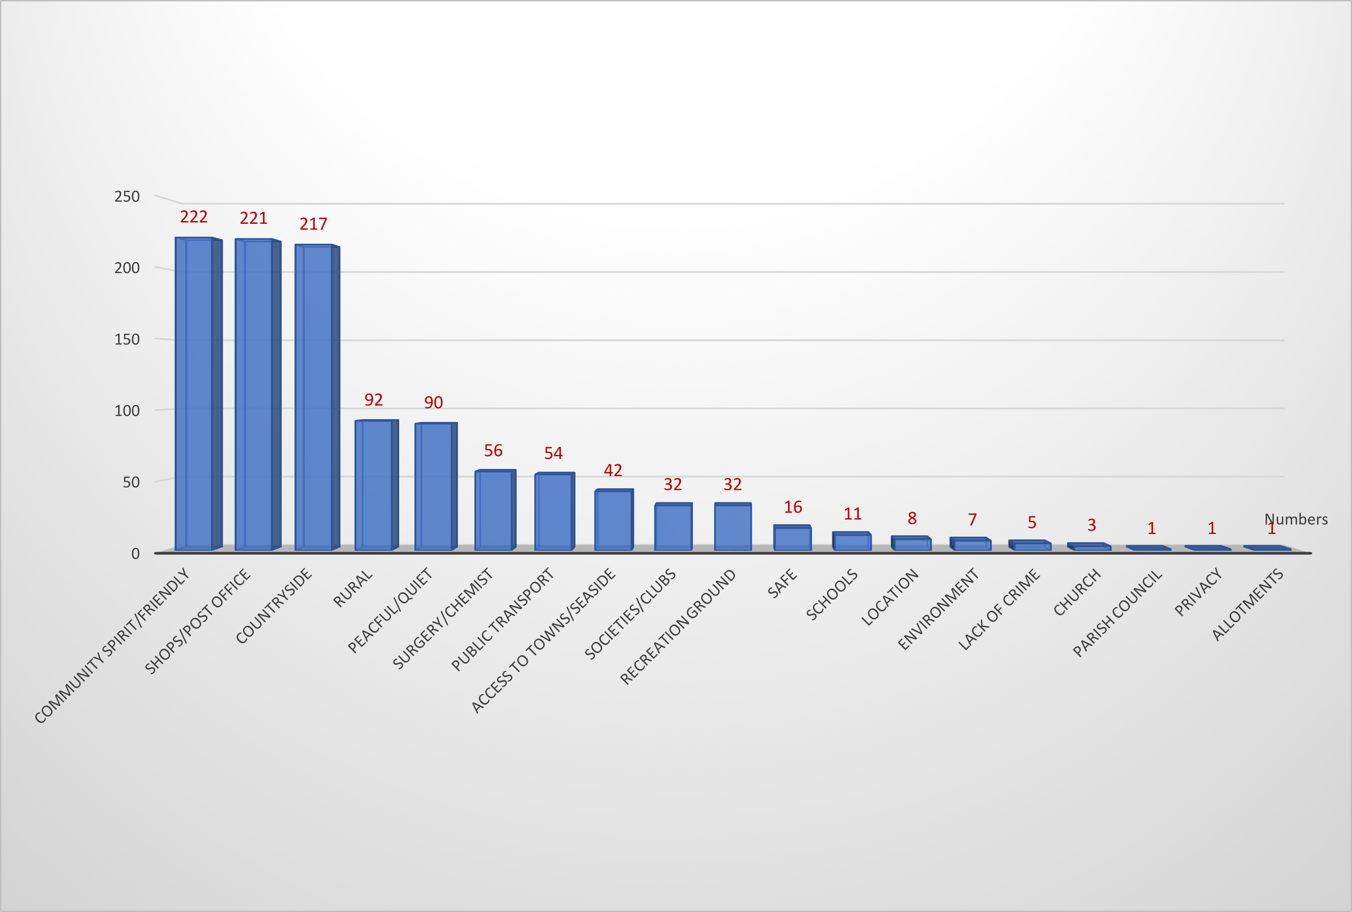
What 3 Things People like in the Parish

Slide 4
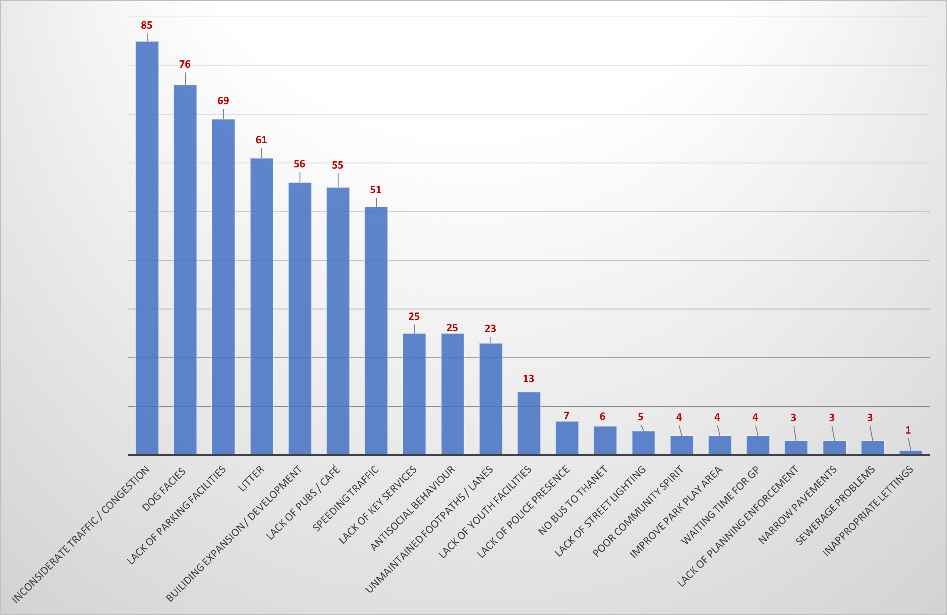
What 3 Things People Dislike in the Parish

Slide 5
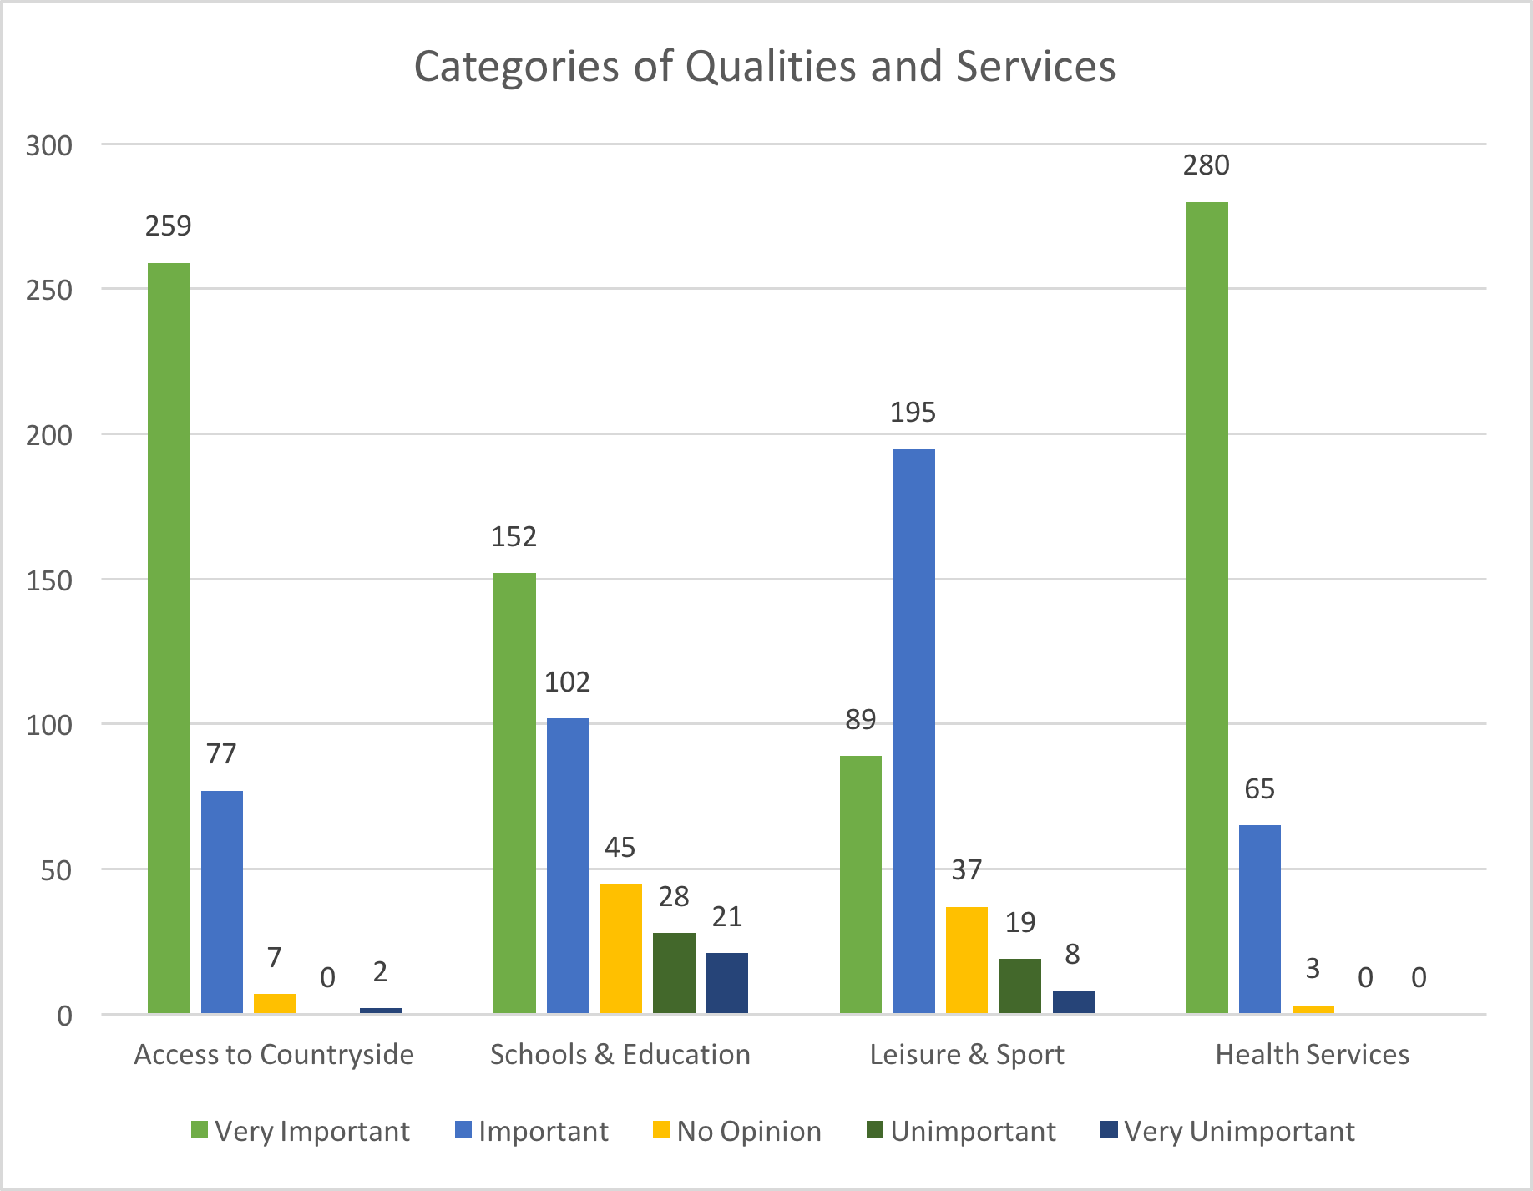
Importance of Qualities and Services

Slide 6

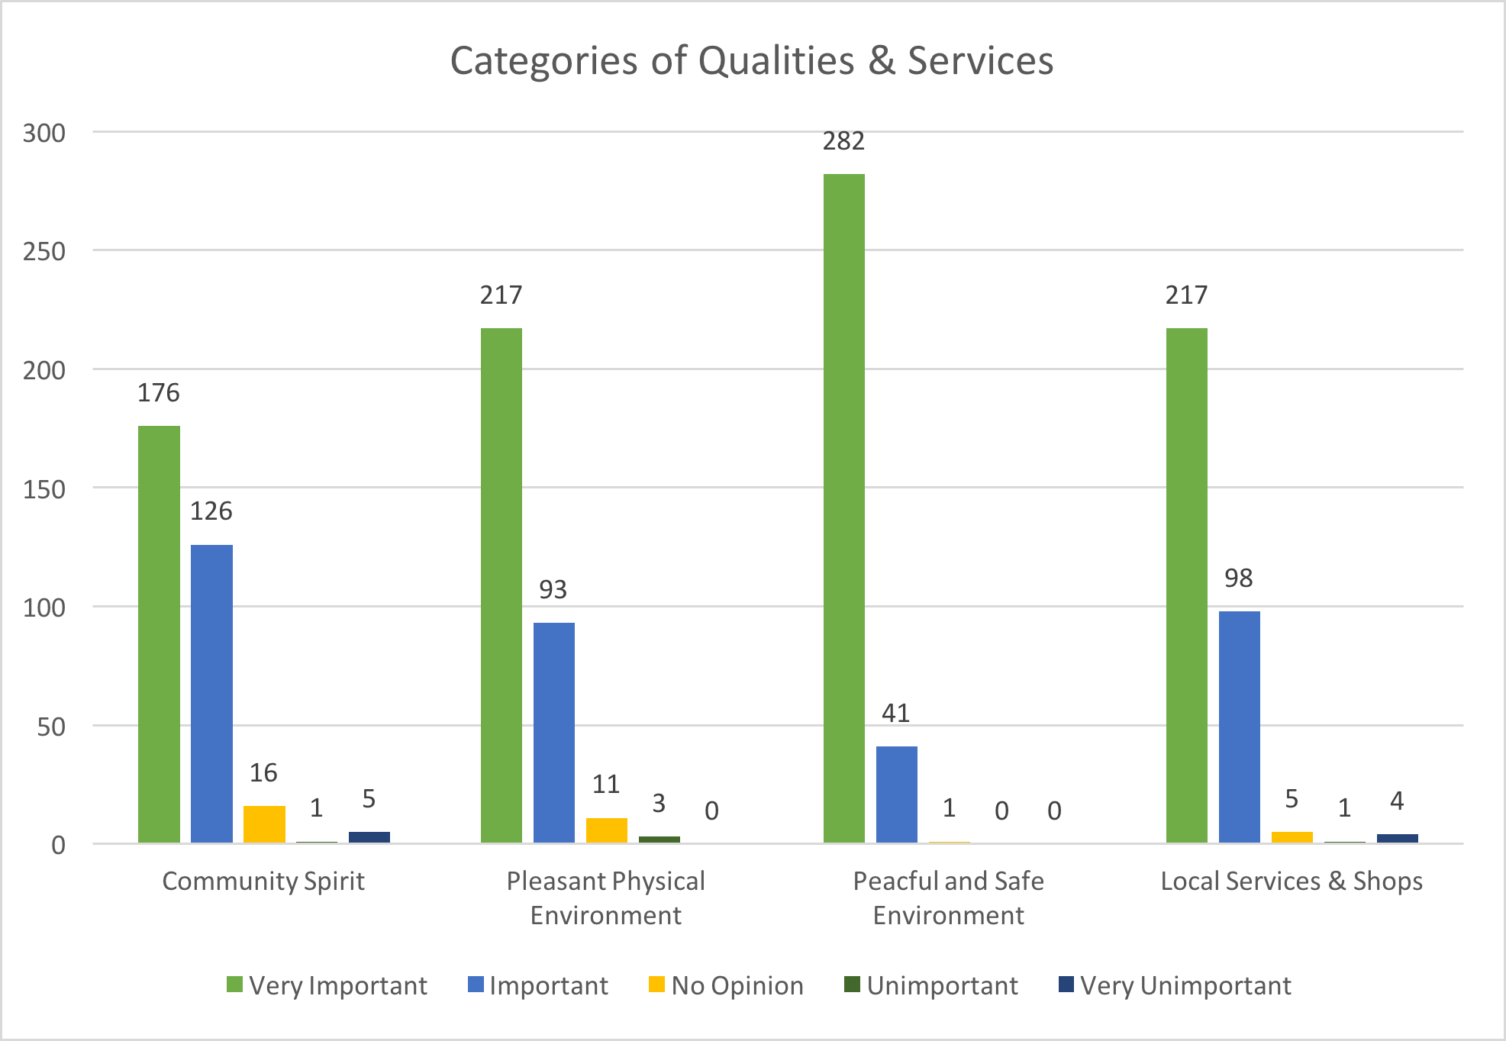
Importance of Qualities and Services

Slide 7
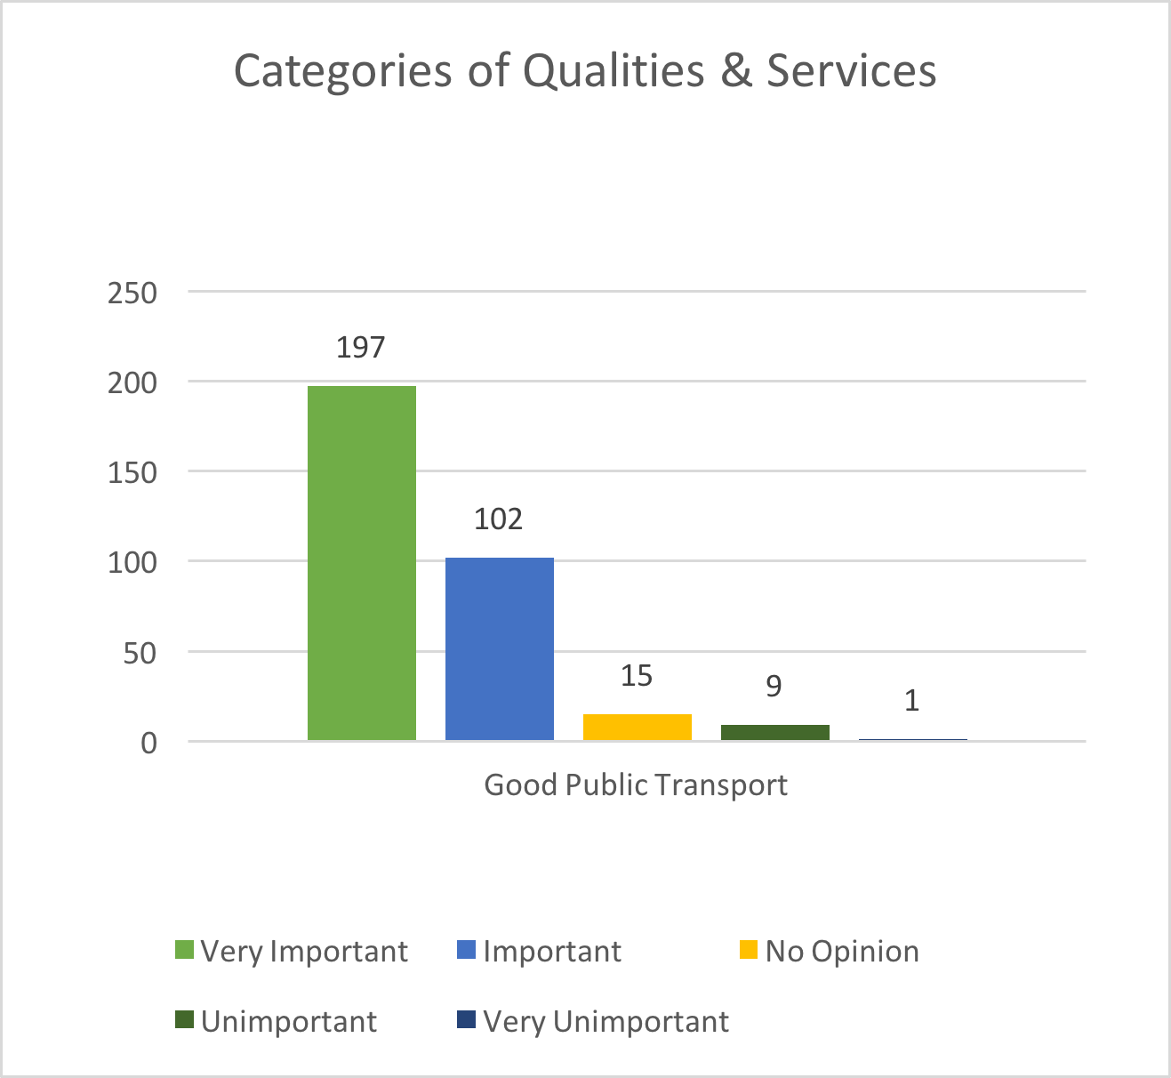
Importance of Qualities and Services

Slide 8
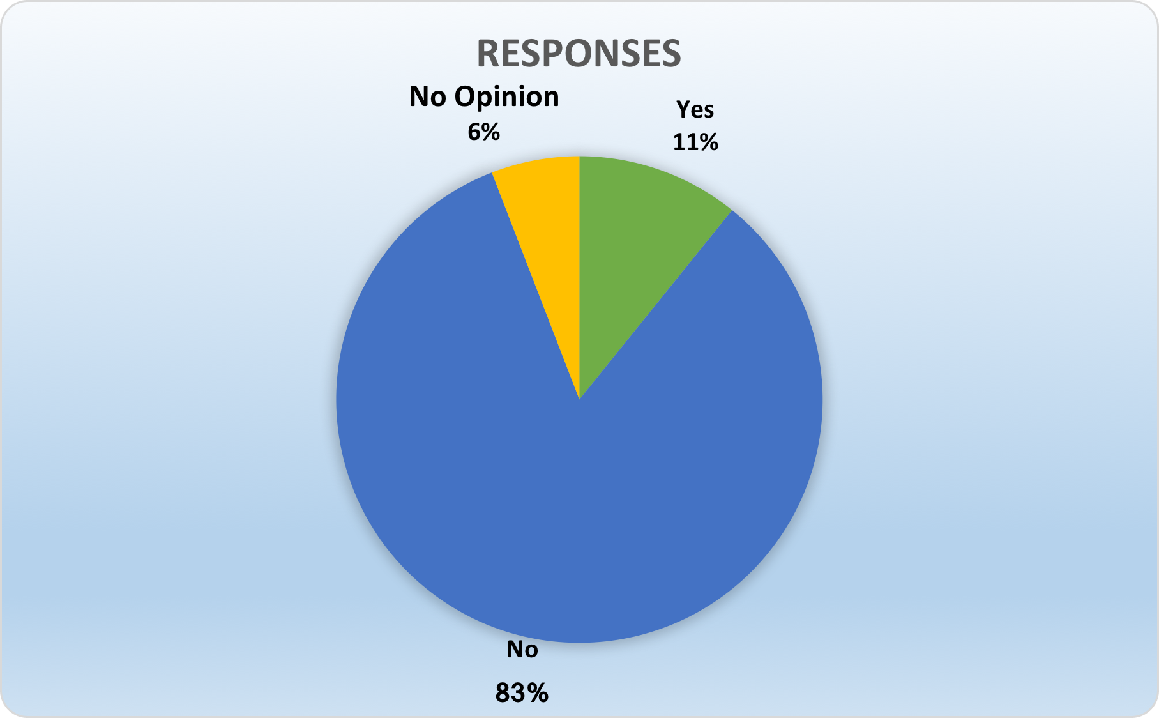
Parish Housing
Should the Neighbourhood Development Plan include the allocation of additional sites for housing?

Slide 9
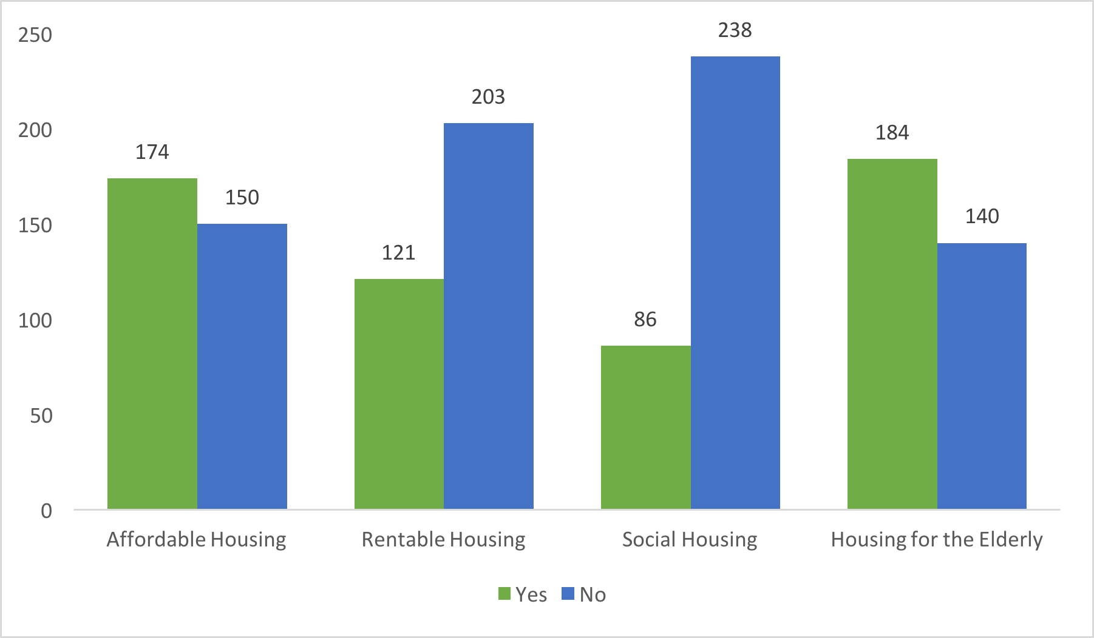
Parish Housing
Opinions regarding the type of housing expansion in the Parish of Ash over the Neighbourhood Development Plan period (2017 – 2026)

Slide 10
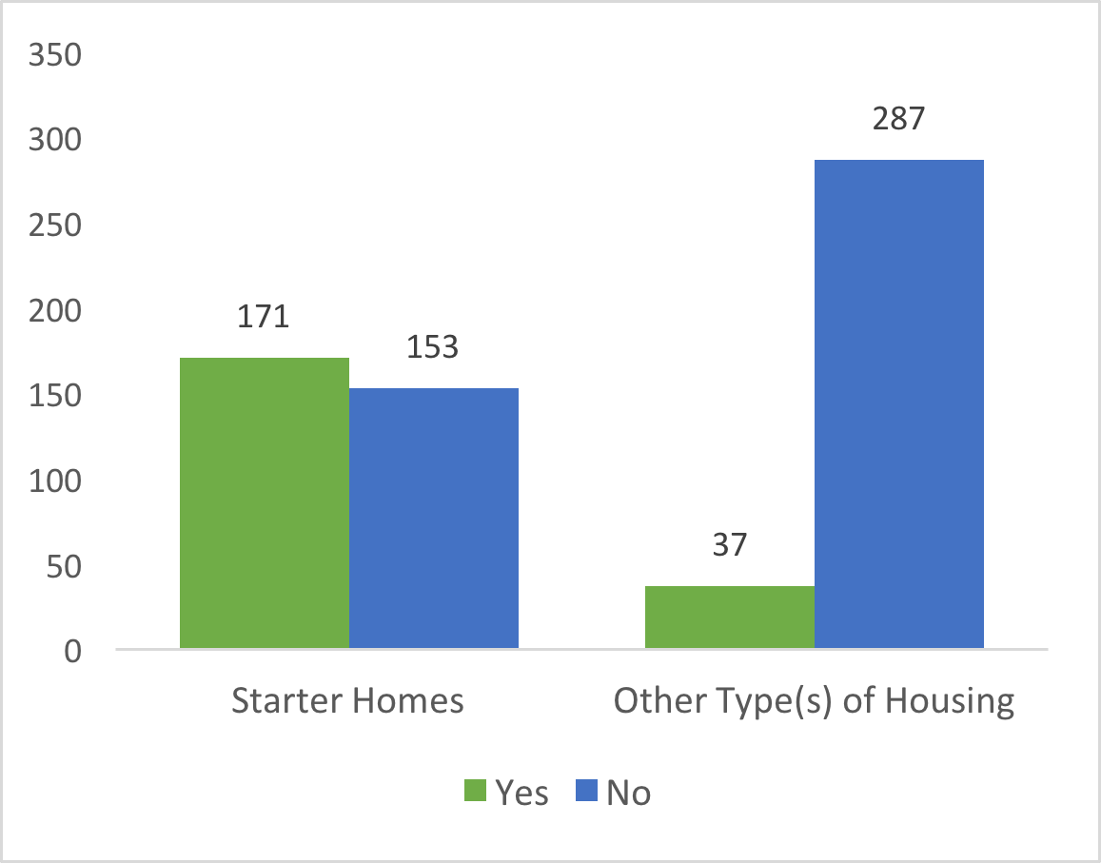
Parish Housing
Opinions regarding the type of housing expansion in the Parish of Ash over the Neighbourhood Development Plan period (2017 – 2026)

Slide 11
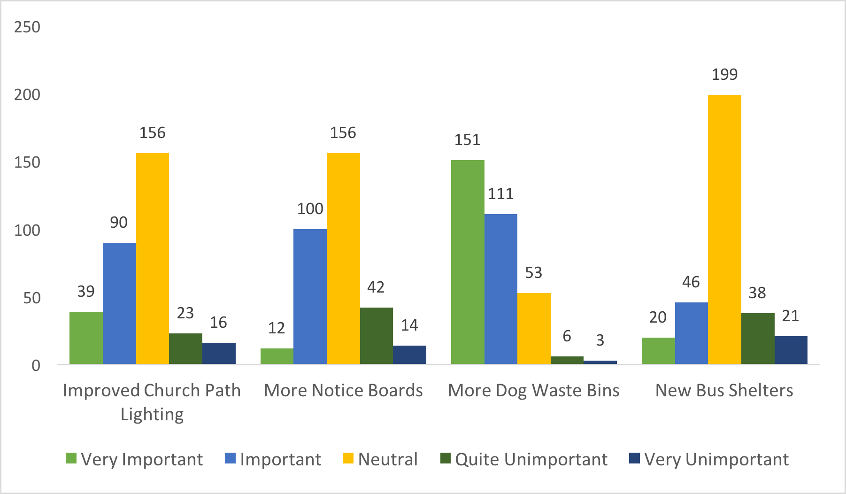
Ash Parish Community Facilities
Importance of Community Facilities:

Slide 12
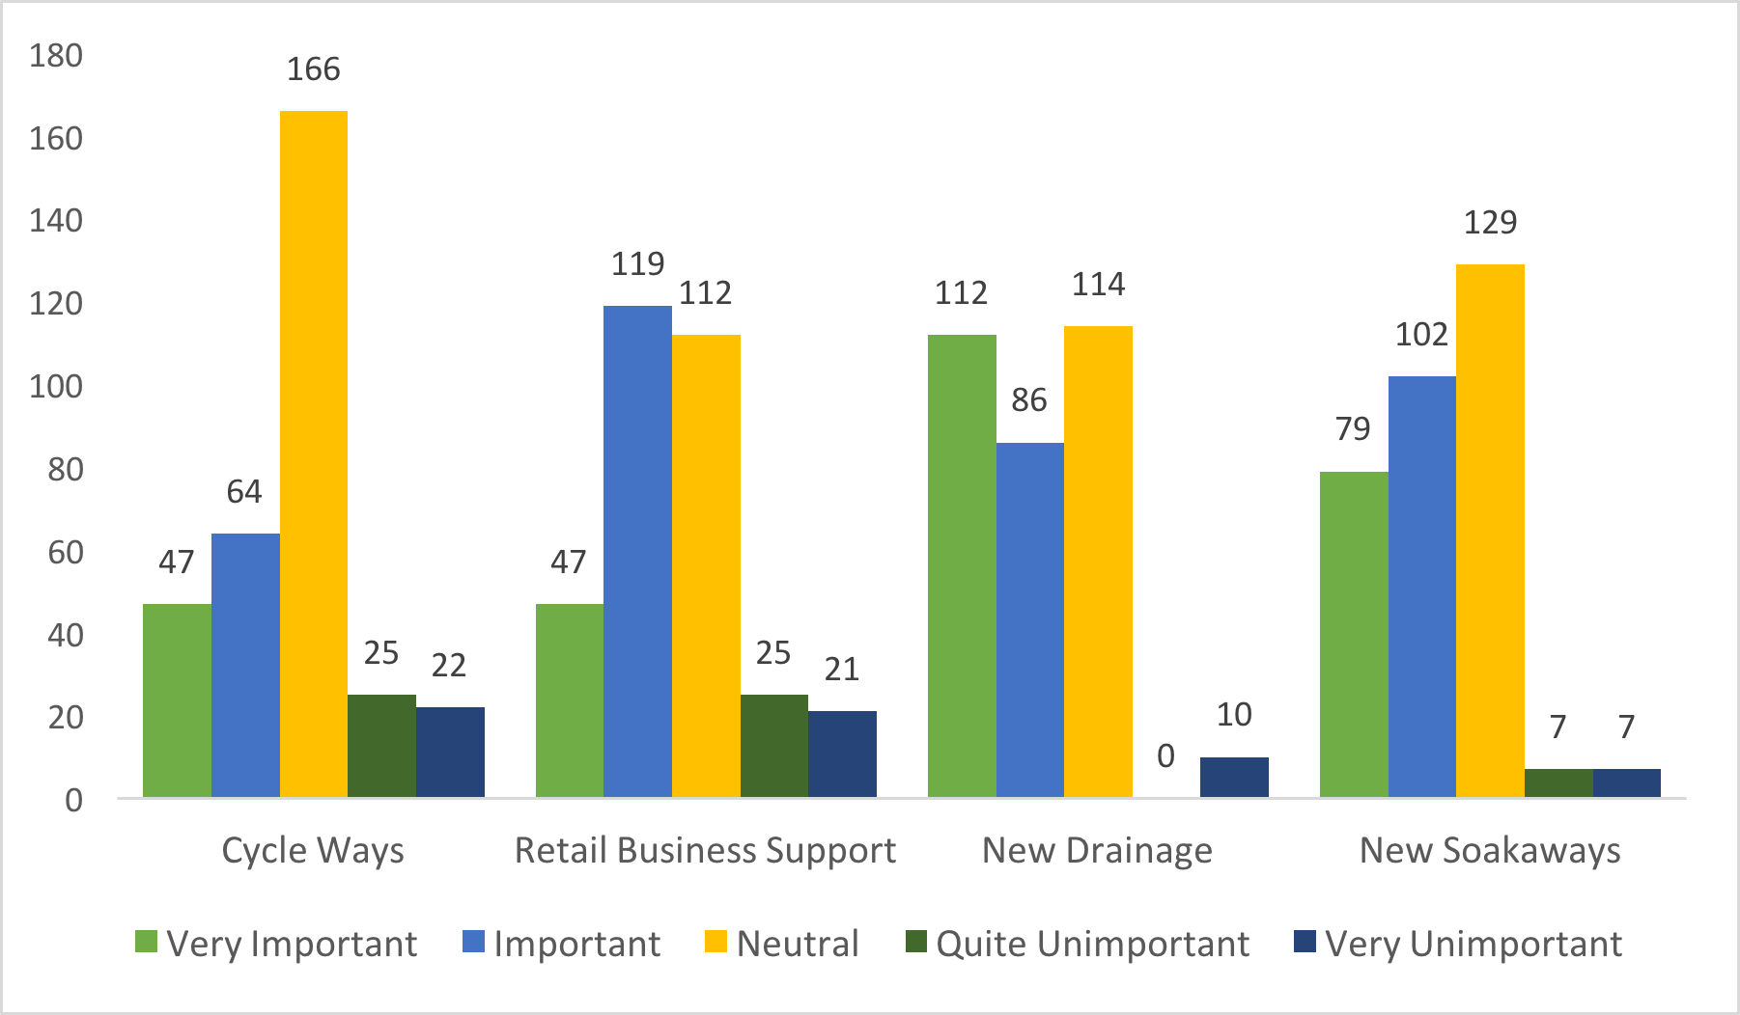
Ash Parish Community Facilities
Importance of Community Facilities:

Slide 13
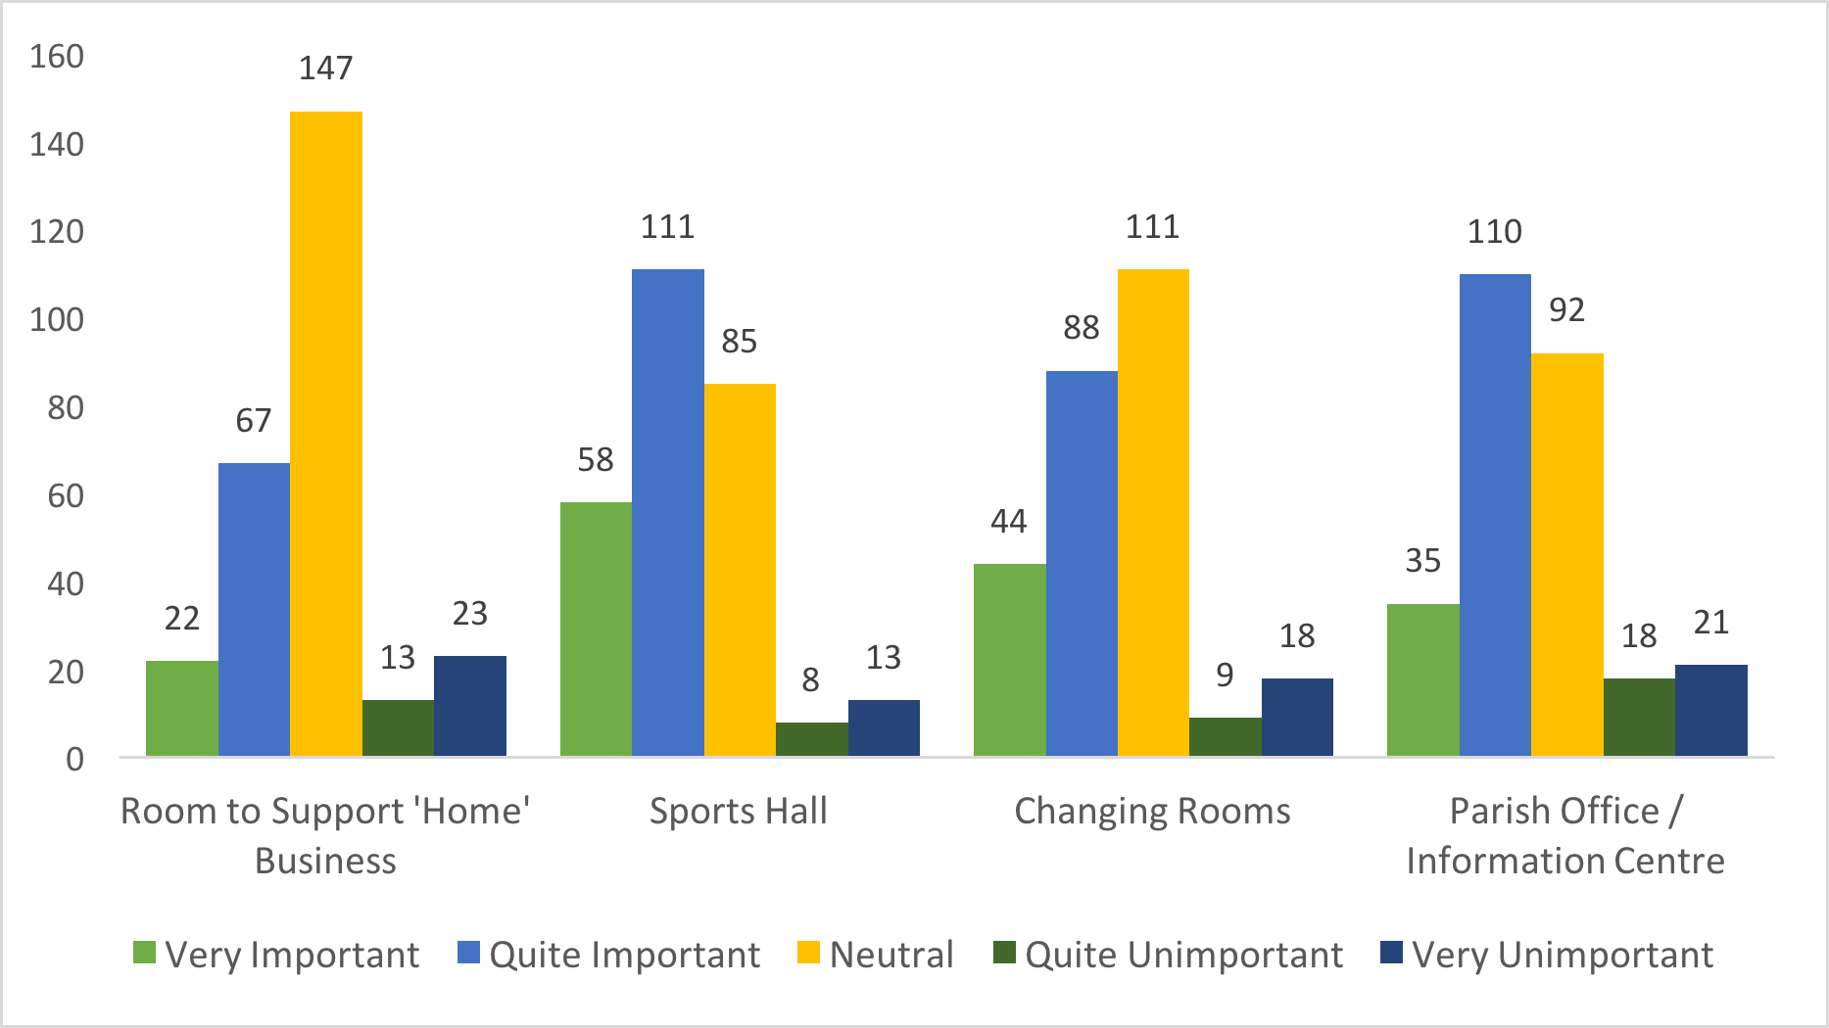
Suggested Additional Community Facilities
Numbers and Types of Suggestions:

Slide 14
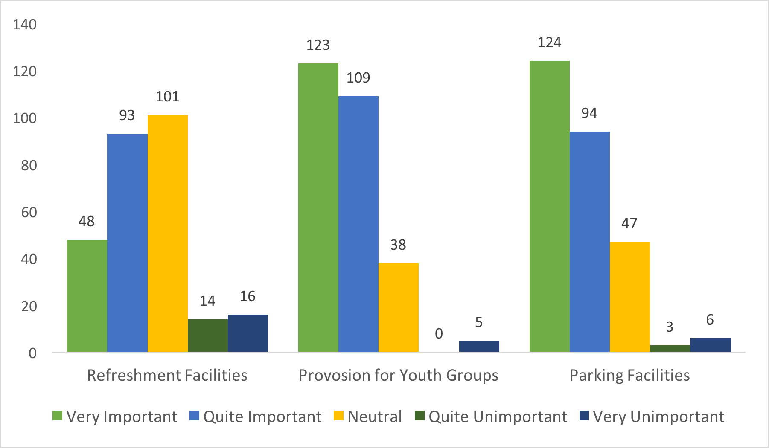
Suggested Additional Community Facilities
Numbers and Types of Suggestions:

Slide 15
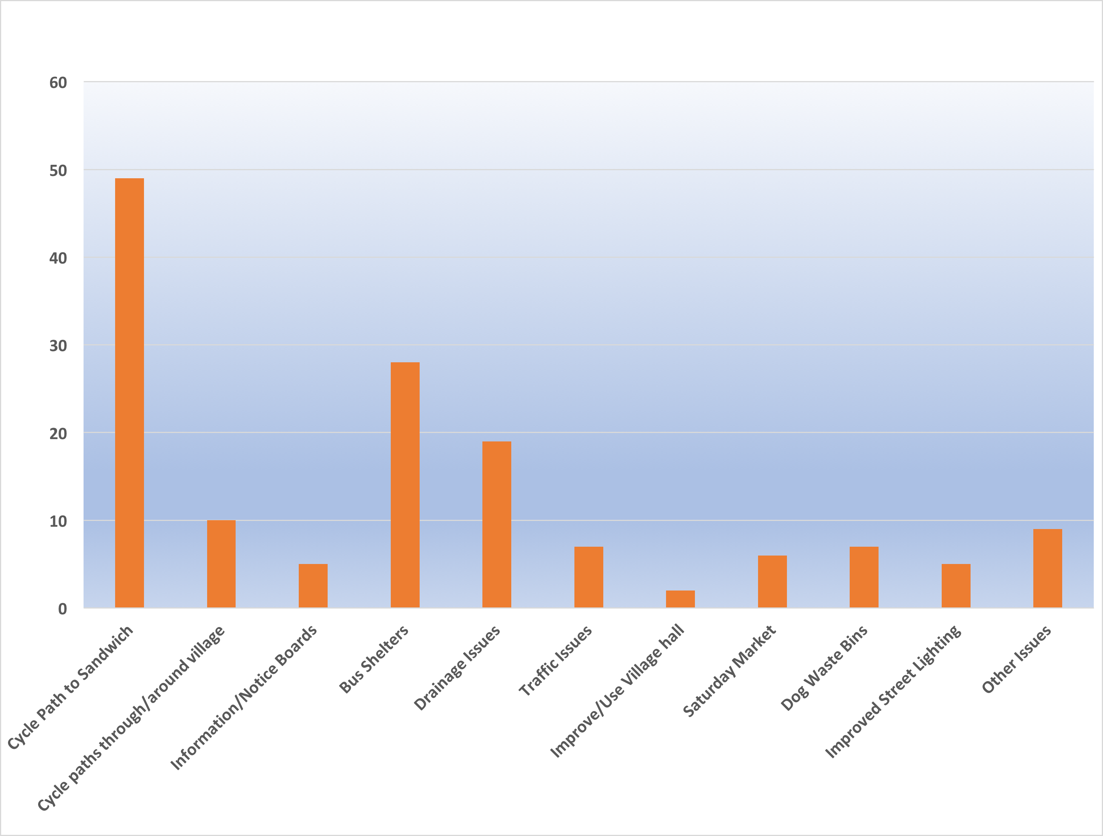
Comments Regarding Additional Community Facilities
Categories of Comments:

Slide 16
Samples of Actual Comments Regarding Additional Community Facilities
Comments From NDP Survey
Dedicated Cycle paths required
Improve Car Parking Facilities
Parish Notice Boards are Essential
Dog Waste is Single Biggest Problem Currently
Sandwich Bound Bus Shelters Needed
Proper Highway Drainage Scheme Required

Slide 17
Samples of Actual Comments Regarding Additional Community Facilities
Comments From NDP Survey
Lighting Needs Improving Around the Village
Village Pub and more Doctors needed
Village needs a ‘Heart’ Teashop and Functioning Pub
Improve Village Hall facilities
Village Homes for Local People, Young and Old

