Slide 1
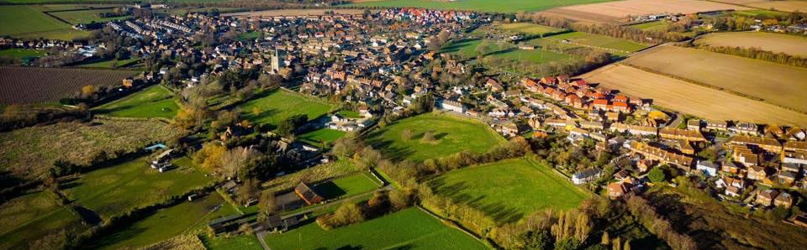

Annual Parish Meeting
29 April 2026

Slide 2
Welcome

Slide 3
Agenda
Approval of minutes of Annual Parish Meetings 2024 and 2025
Ash Parish Council
Dover District Council
Kent County Council
Local Charities
Ash Surgery
Resolutions given written notice
Any other relevant Parish business
Notes:
Apologies from MP Sir Roger Gale and Police
Q&A after each speaker

Slide 4
Approval of minutes of last meetings
Available on the Ash Parish Council website
  https://ashparishcouncil.gov.uk/
Minutes of Meeting 18 April 2024
Minutes of Meeting 30 April 2025

Slide 5
Ash Parish Council
Cllr Ian Ellery

Slide 6
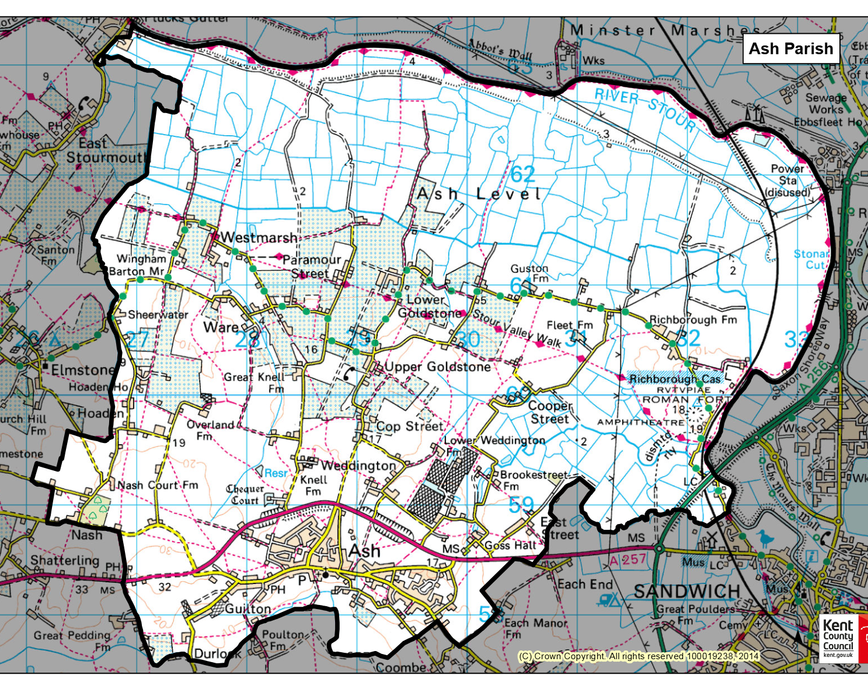
Ash Parish
Area: 8.59km²

Slide 7
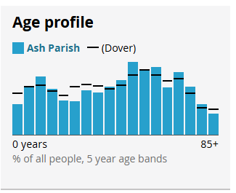
About the Parish
Civil Parish of Ash, established 1894
Ash Parish Council, 11 councillors
Within Dover District Council and Kent County Council
Parliamentary Constituency of Herne Bay and Sandwich
Population (2021): 3,300 in 1,400 households
Official Electorate (Feb 2026): 2,780
Notes:
Note local gov reorg
Graph from last census

Slide 8
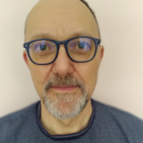
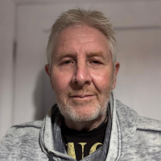
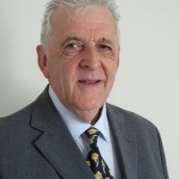
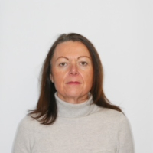
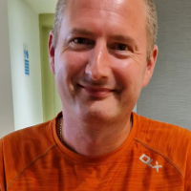
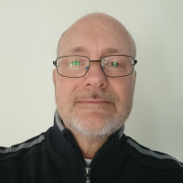
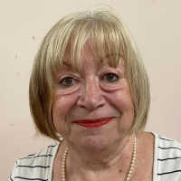
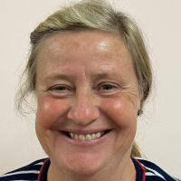
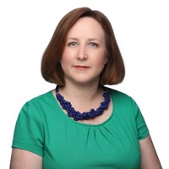
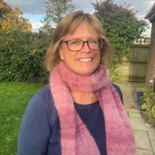
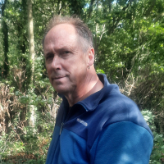
Your Parish Council
Ian Ellery (Chair) | John Tanner (Vice Chair) | Martin Porter | Louise Venny
Ashley Stevenson | Arnold Davies | Annette Rose | Lynn Gambrell
 | Sarah Rush (Clerk) | Joanna Jones (RFO) | Duncan Wild (Caretaker)
Notes:
We have 2 vacancies

Slide 9

Your Parish Council Needs
YOU
We have three vacancies and would welcome new councillors
Please contact the Clerk for more information

Slide 10
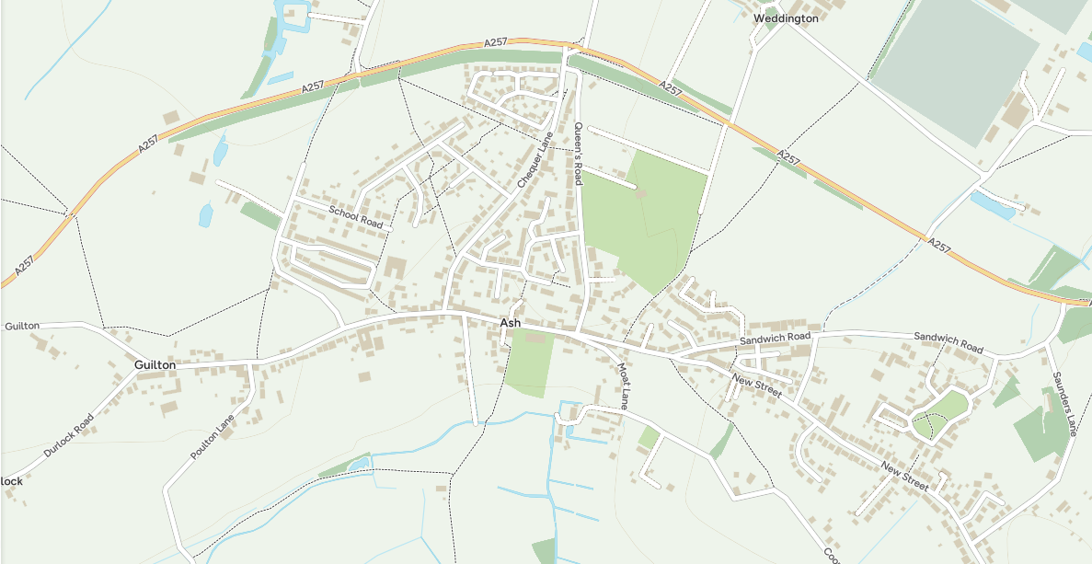
Planning and Enforcement: DCC
Roads: KCC
Potholes: KCC
Rec Car Park: APC
Recreation Ground: APC
Rec Toilets: APC
Streetlights: KCC
Allotments: APC
Streetlights: DCC
War memorials: APC
Yellow Lines - Location: KCC
Yellow Lines - painting: DDC
Toilets: DDC (funded by APC)
Car Park: DDC
Litter and bins: DDC

Slide 11

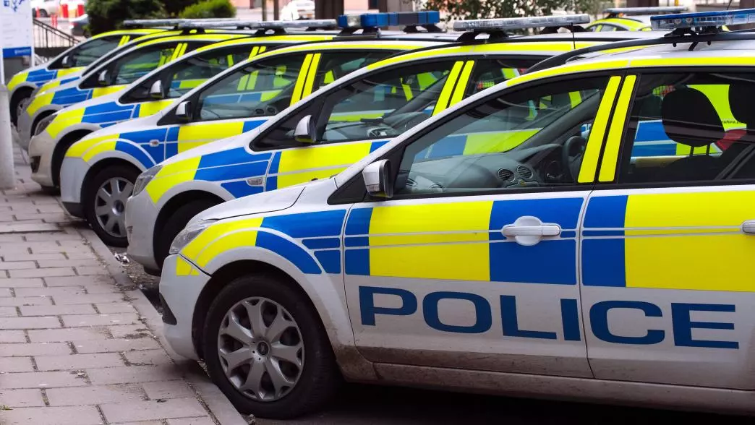
Anti Social Behaviour
Must be reported to the Police
No reports means no issues
Social Media is NOT reporting!
CCTV removed from Ash as “there were no reported issues”
999 Danger to life
101 Non-emergency
Online Kent Police Website
Live Chat direct to Maidstone control room
www.kent.police.uk

Slide 12
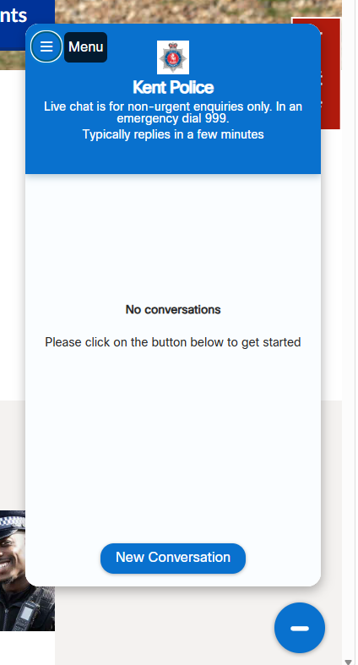
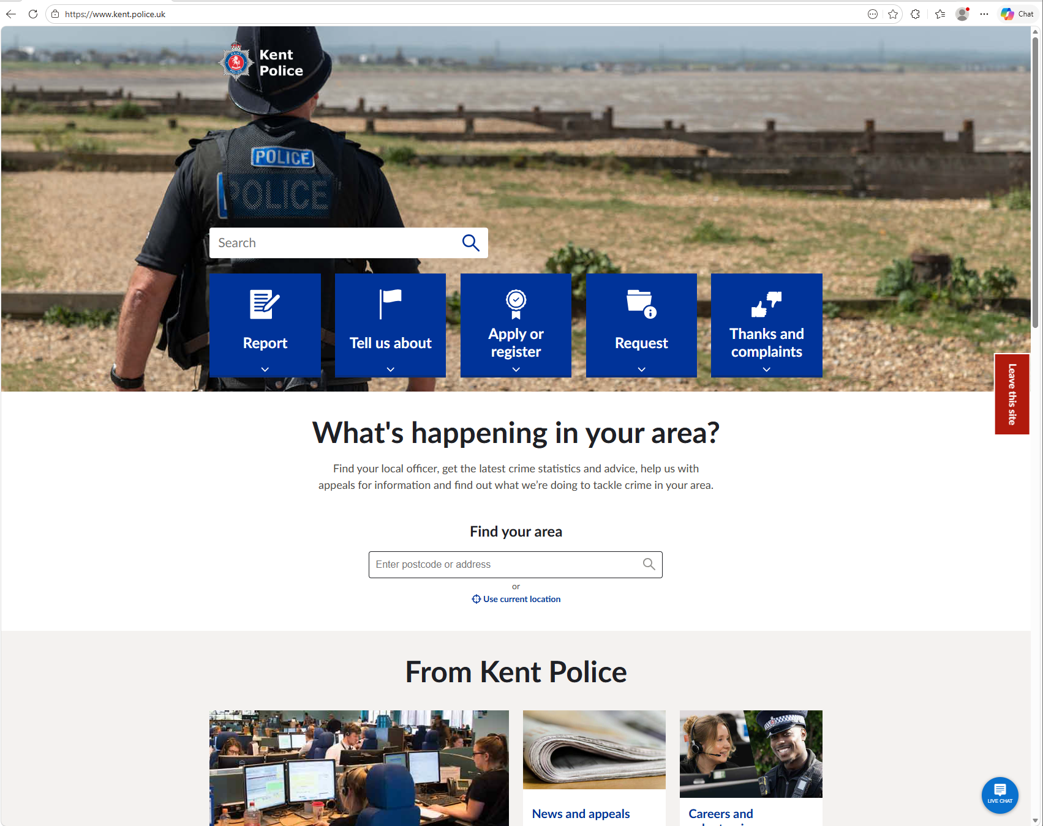
Anti Social Behaviour
Report Crime
Live Chat

Slide 13
Unaudited Finance Report 2025/2026
Budget set = £107,282.30
Actual Income = £123,124.51
Actual expenditure = £122,217.23
Main changes:
  £9,292 grant from DDC for allotment fencing
  Higher spend on play area repairs, but matched by S106 income
  Bank interest rate increase
  Employment costs have risen
  Repairs to Rec toilet block
Notes:
Note that these figures are unaudited

Slide 14
2025/2026 Grants Awarded
£200 Ash Advent
£229 Ash Baby & Toddler Group
£500 Ash Heritage Centre
£745 Ash Wildlife Friendly Village
£500 Parochial Church of Ash
£400 Westmarsh Village Hall
£2,574 in total

Slide 15
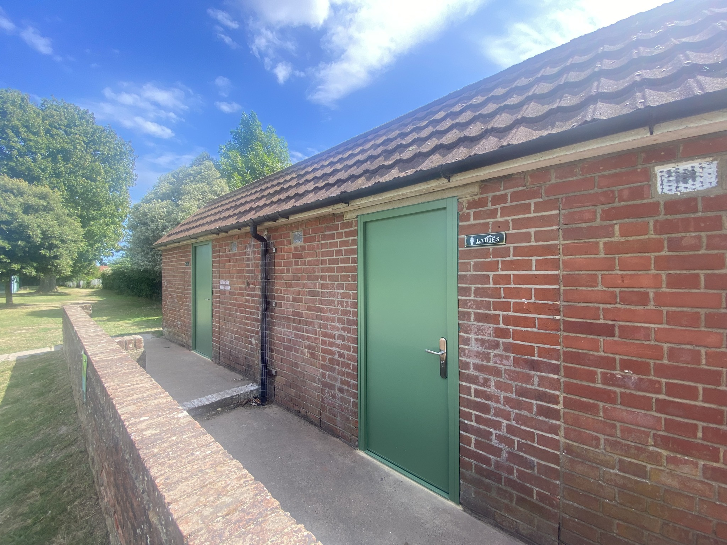
What have we delivered this year?
New toilet doors
Redecorated

Slide 16
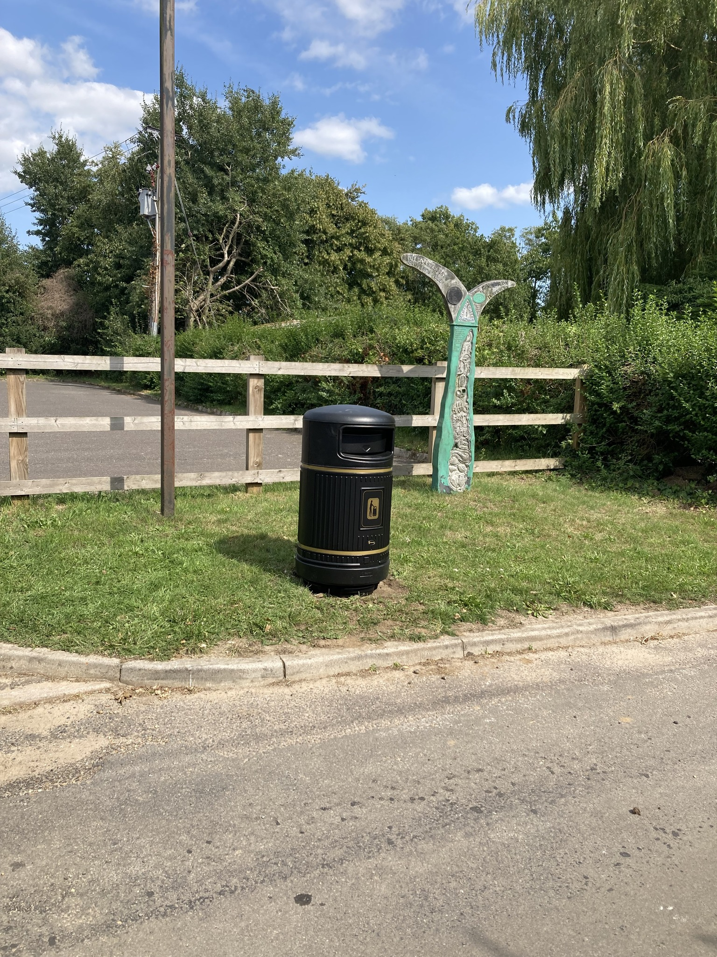
What have we delivered this year?
New bin at Westmarsh

Slide 17
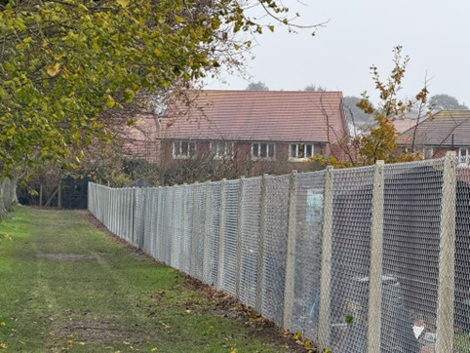
What have we delivered this year?
Replaced allotment fence
Plus double wide gates

Slide 18
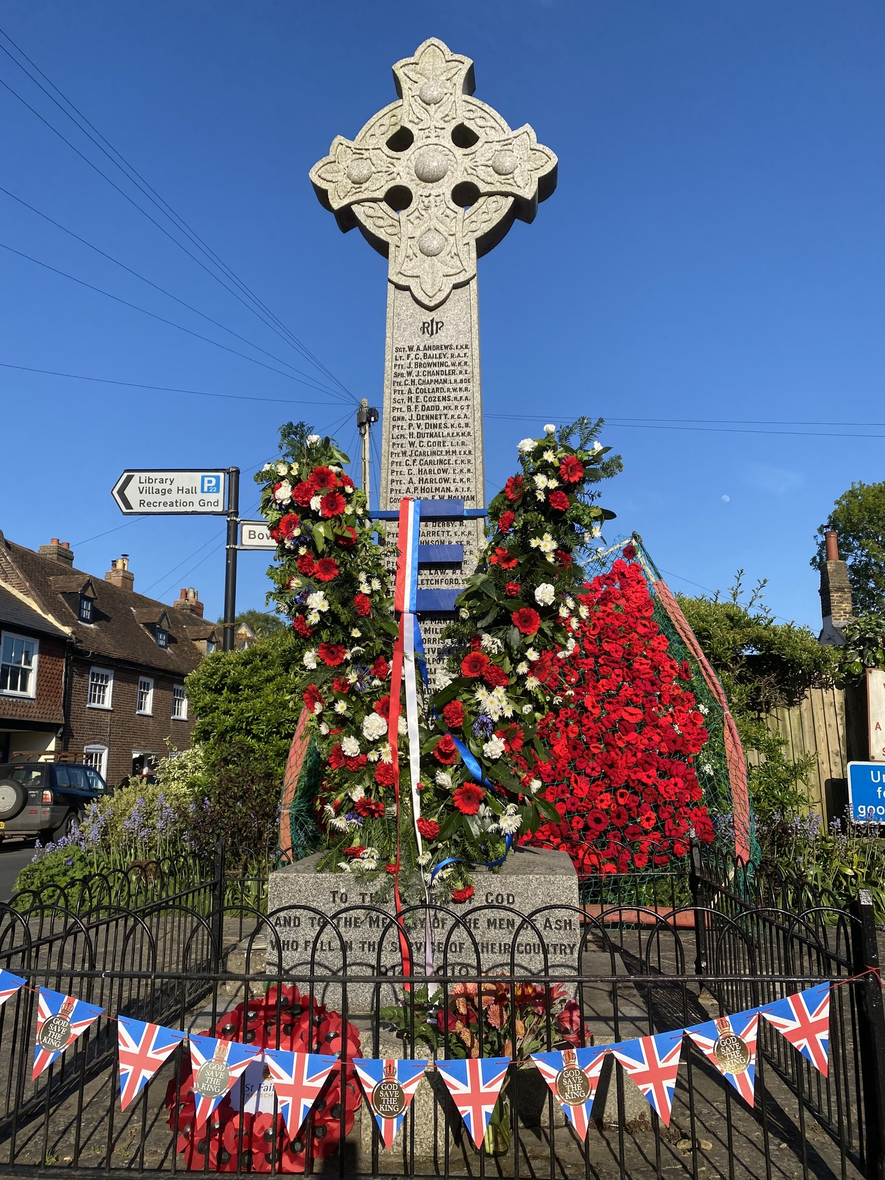
What have we delivered this year?
Funded VE day flowers

Slide 19
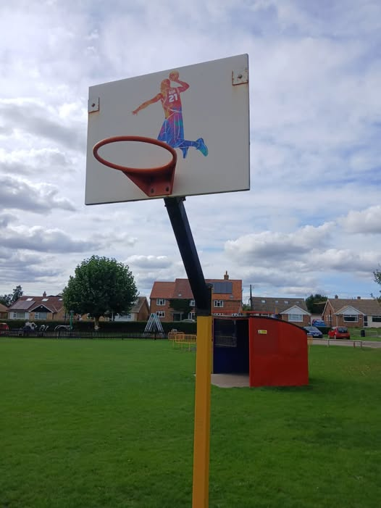
What have we delivered this year?
Repairs and upgrade to
basketball hoop

Slide 20
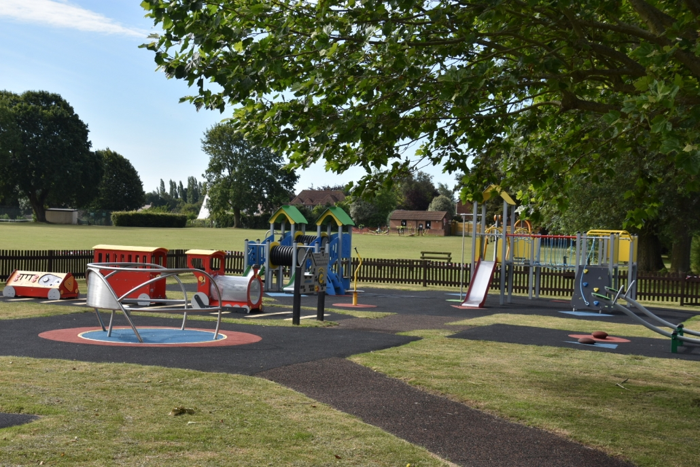
What have we delivered this year?
Maintained and repaired
play areas and adult gym

Slide 21
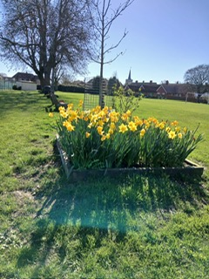
What have we delivered this year?
Bulb Bomb!
Grant given to
Ash Wildlife Friendly Village

Slide 22
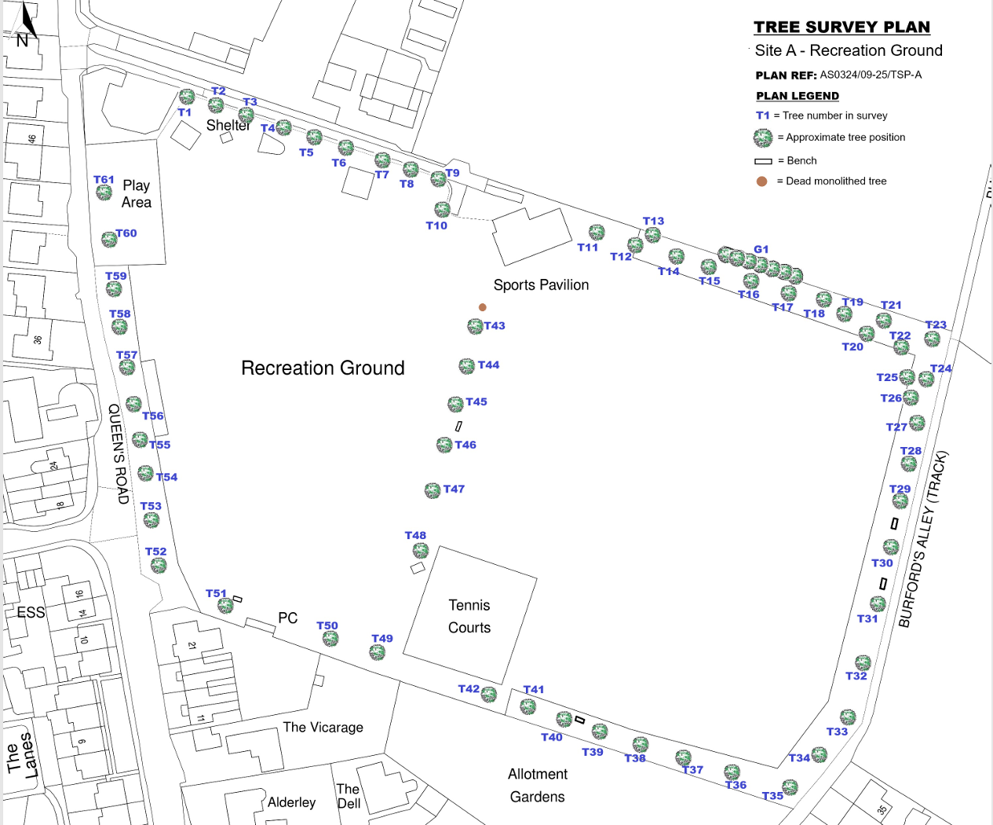
What have we delivered this year?
Tree survey of all 61 trees
on Rec plus 2 at Pound Corner

Slide 23
Plus: all our usual regular activity
Recreation Ground
Grass and hedges cut
Village
Toilets
Seats maintained
Play equipment
Exercise equipment
Pound Corner
Bus shelters
War memorials
The Street
Recreation Ground
Allotments
34 plots
Marked and inspected
Water supply
Waste bins

Slide 24
Planning
In the NDP, the Parish Council agreed to report on the number of “windfall” or “infill” houses.
These are houses built outside of the larger recognised developments.
Year planning agreed | Not Yet Built | Completed
2017 |  | 2
2018 |  | 4
2019 |  | 1
2020 | 1 | 4
2021 | 1 | 6
2022 | 4 | 7
2023 | 10 | 1
2024 | 6
2025
 | 22 | 25
Year Completed | Number Completed
2021-22 | 7
2022-23 | 6
2023-24 | 6
2024-25 | 6
 | 25
Data up to March 2025
Notes:
NDP allows 2 per annum, 38 over lifetime of NDP (2018-2037, 19 years)

Slide 25
Finance Report 2026/2027
Latest News:
20mph limit consultation had 71% in favour
Budget agreed as £224,676
Seems much higher than previous years as it includes £115,000 for Play Area 2
But precept increased by just 3.4% from 25/26
Projects
  Play Area 2
  Consultation on 20mph limit
  Review of Neighbourhood Development Plan
  Beating the Bounds
Plus all the usual maintenance and repairs

Slide 26
Play Area 2 Funding

Slide 27
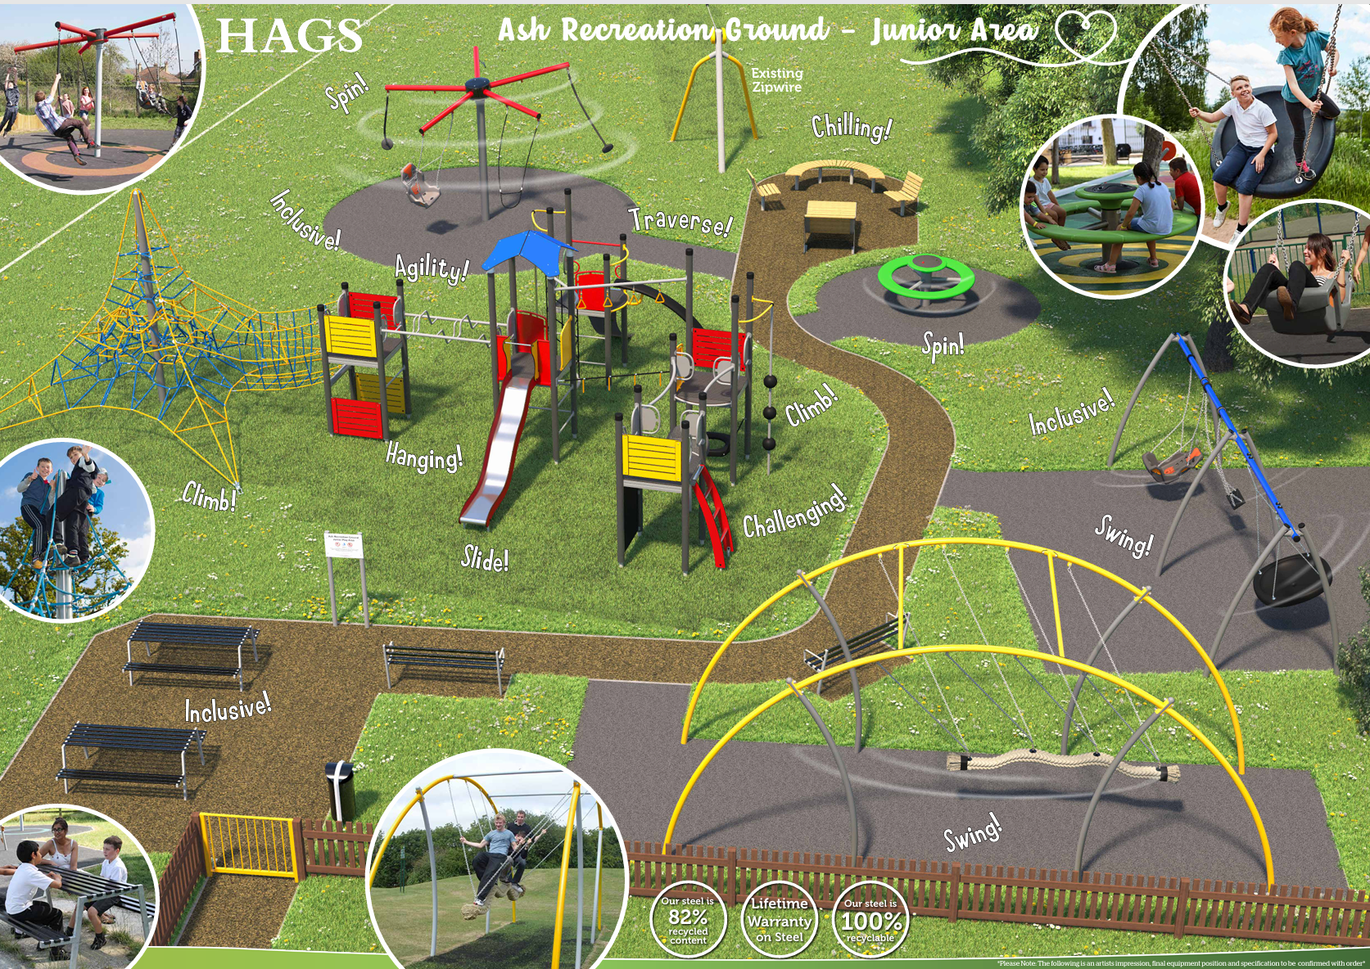
Build from May to June 2026
Celebration opening day
Watch for news!!

Slide 28

Looking to the future
What does the village want beyond 2026/2027?
Notes:
What does the parish want? Plans beyond this year?

Slide 29


Slide 30

KALC Community Award
The Kent Association of Local Councils (KALC) Community Awards give recognition to a resident of the Parish of Ash who has made a significant contribution to our community
Residents were invited to nominate with the winner chosen as the person who received the most nominations
And the Winner is…..

Slide 31


Louise
Venny

Slide 32
Dover District Council
Cllr Martin Porter

Slide 34
Kent County Council
Cllr Peter Evans

Slide 36
Local Charities
Jack Foat’s Trust
Kelsey and Cartright Charity
Frank Kingsland Trust
Ash United Charities

Slide 38
GP Surgery
Dr Aleksandra Fox

Slide 40
Other Business
Any resolutions for which written notice has been given
Any other business concerned with Parish Affairs

Slide 41
Many Thanks to…
Local groups who have attended tonight
St Faith’s School for hosting and refreshments
All of the speakers for attending and their informative talks
Parish councillors for their commitment, time and energy
Our tireless Clerk for organising and managing the council, our RFO for keeping us on budget and our Community Caretaker for ensuring parish council assets are kept neat and tidy
But mainly – you all for being part of this parish and making it such a great place to live

